Slide 1
Video Game Analysis & Technical Design
  Ch.7 TDDs, ADDs & UML

Slide 2
Introduction
Define how the game will be created
  Technical Design Document
  Art Design Document

Slide 3
Technical Design Document
Purposes
  Determines needed code modules
  Determines what tools and software are needed
    Use only licensed software

Slide 4
Technical Design Document
Purposes
  Determines coding standards
    Avoid “spaghetti code” others cannot understand
  Determines when new programmers need to be hired
  Determines timeline and milestone schedule

Slide 5
Structure of the TDD
Introduction
Main game loop
Game application modules
Artificial Intelligence modules
Graphics engine

Slide 6
Structure of the TDD
Networking
Audio
User interface and inputs
Coding standards
Development tools

Slide 7
Introduction
Game concept
  Recap of the game design
Platform requirements
Technical goals
  Perhaps creating a new game engine
Risks
  Potential pitfalls

Slide 8
Introduction
Internal and external tools
  What to build/what to buy
Timeline and milestones

Slide 9
Main Game Loop
How does code function from start to finish
Called once per animation frame
Frame rate
  Time an action remains on the screen

Slide 10
Game Application Modules
Game objects
  Every object in the game
  Controlled by an object manager
Characters/units
  Mechanics for controlling main units

Slide 11
Game Application Modules
Weapons
  How are attributes used by the game engine
  How will graphics work
Projectiles
  Generation
  Motion
  Collision

Slide 12
Game Application Modules
Level loading
  How/when are levels loaded into memory
Terrain/level loading
  Does play stop while level is loading
  Special effects such as weather

Slide 13
Game Application Modules
Physics
  Motion
  Gravity
  Collision

Slide 14
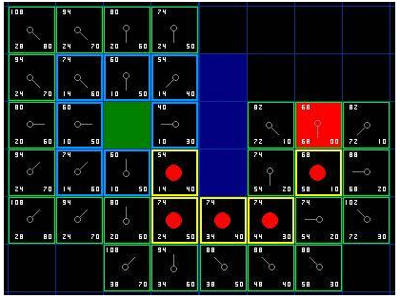
Artificial Intelligence Module
Pathfinding
  How do AI-controlled objects move about
  A*
    One standard approach
Tracking
  “fog of war”
    Enemy is unseen

Slide 15
Artificial Intelligence Module
Target selection
  How to prioritize targets
Behaviors
  How will AI-controlled objects behave

Slide 16
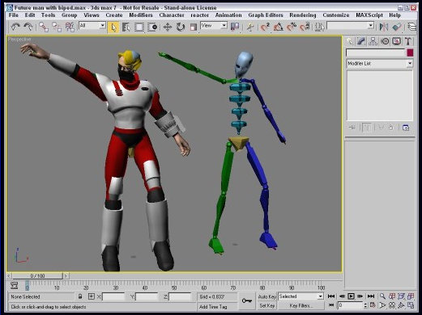
Graphics Engine
Rendering system
  Create
  Use an existing application program interface (API)
Models
  Handles 3D models in the game
Animations
  Animation of 3D objects

Slide 17
Graphics Engine
Textures
  Deals with adding textures to 3D objects
2D graphics
  menus
Particles
  Blood spatter
  sparks

Slide 18
Graphics Engine
Text
  What font will be used
Camera
  What point of view will be used
Renderer
  Rendering system
    Initialization
    Destruction

Slide 19
Graphics Engine
Display manager
  For computer games
    Full screen
    Windowed mode
Lighting, shadows, and other special effects
Special animations
  Reaction to a hit
  Carrying a weapon

Slide 20
Networking
Client and server operation
  Server
    Hosts the game
  Client
    Platform player uses
  Dedicated server
    Serves one purpose only

Slide 21
Networking
Protocol
  Regulates transmission of data on a network
  User Datagram Protocol/Internet Protocol (UDP/IP)
  Transmission Control Protocol/Internet Protocol (TCP/IP)

Slide 22
Networking
Packet structure
Packet
  Transmitted between computers

Slide 23
Networking
Game specific information
  Competitive mode
  Cooperative mode
Online chat
  Allows user to send text messages while playing
Other servers
  Customer purchases
  Subscriptions

Slide 24
Networking
Latency
  Time required for a packet to travel to its destination
Warping
  Slow machines
  Characters appear to jump in gaps

Slide 25
Audio
Audio format
  Sampling rate
  Number of channels
  File format
Compression/decompression
  Of audio files

Slide 26
Audio
Sound manager
  Handles audio functions
  Works with sound card
Special audio effects
  Surround sound
  Music themes

Slide 27
User Interface and Inputs
Interface screens
Playfield
Menus
Buttons
Keys
Joysticks

Slide 28
Coding Standards
Well-defined coding style
File formats
File structure
Pointers and references
Commenting

Slide 29
Development Tools
Discuss functionality of tools
Level editor
Map editor
Graphics
Animation
Audio
Scripting/programming language

Slide 30
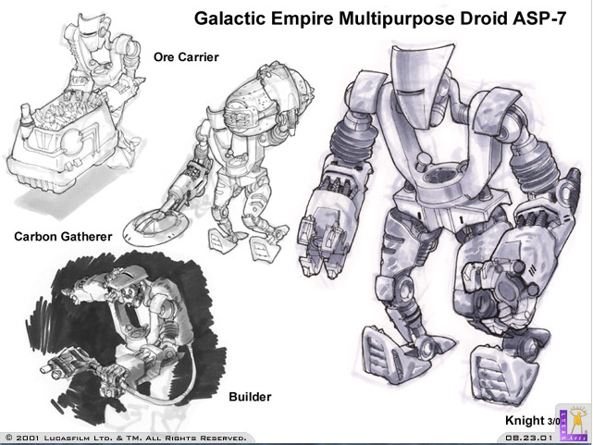
Art Design Document
For the art team
Breaks down art requirements
Central repository for artists’ reference

Slide 31
Structure of the ADD
Introduction
Character/Units
Environment locations
Items
Animated sequences
User interface

Slide 32
Structure of the ADD
Title screen and company logo
Licenses
Fonts
Miscellaneous art

Slide 33
Introduction
Should list the game specifics (like the TDD)
Should also list the intended audience, gameplay, and focus (which influences the art produced!)

Slide 34
Character/Units
Character/Units Names
Description
  Specifies what each character/unit will look like
Actions
  Lists all actions a character can perform

Slide 35
Character/Units
Physical dimensions
  Heights
  Widths
Template (turnaround in animation)
  2D template showing
    Front
    Back
    One side

Slide 36
Character/Units
Animation flowchart
  Shows how all animation works together
Technical information
  Frames per animation
  Rigging method
File names
  List of art files for each character

Slide 37
Environment Locations
Location name
Description
  What will the location look like
Animation features
  Animated terrain features

Slide 38
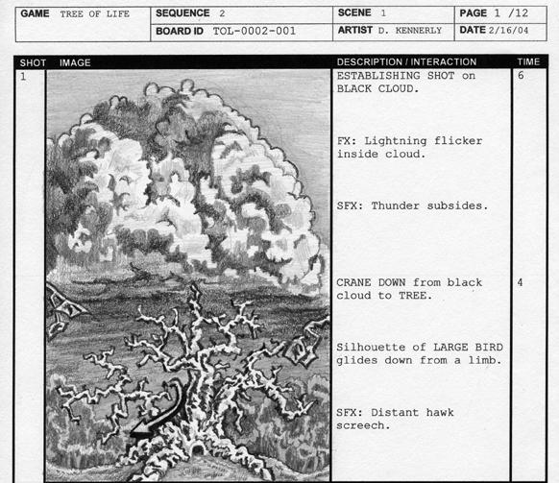
Environment Locations cont.
Special terrain/Environment objects
  Features with special significance
Storyboards/sketches
  Concept sketches for the location
File names

Slide 39
Items
Item name
  Unique name for each item
Description
  What will the item look like
Item appearances
  Where will the item appear in the game

Slide 40
Items
Animations
  What happens
  Number of animation frames
Sketches
  2D sketches of the item
File names

Slide 41
Animated Sequences
All animation
  Real-time animations
  Pre-rendered sequences
What dialogue is needed
Estimate running time

Slide 42
User Interface
Graphic style for all interface screens
What will be full screen
What will be in a pop-up window

Slide 43
Title Screen and Company Logo
Artwork and font that will be used in marketing

Slide 44
Licenses
Artwork needed from licensee
Requirements

Slide 45
Fonts
Create
License
Localization issues

Slide 46
Miscellaneous Art
Icons
Art for the installer
Decorations for dialogue boxes

Slide 47
The Unified Modeling Language
Unified Modeling Language (UML) is a standardized general-purpose modeling language
UML includes a set of graphical notation techniques to create abstract models of specific systems, referred to as UML model
UML is developed as a graphical language for
  Visualizing
  Specifying
  Constructing
  Documenting
It can be used to document:
  Conceptual things such as business processes
  System functions
  Programming language statements
  Database schemas
  Reusable software components

Slide 48
The Unified Modeling Language
It is very important to distinguish between the UML model and the set of diagrams of a system
A diagram is a partial graphical representation of a system's model
The model also contains a "semantic backplane“
  Documentation such as written use cases that drive the model elements and diagrams

Slide 49
Building Blocks of UML
Things
  Structural things
  Behavioral things
  Grouping things
  Annotational things
Relationships
  Dependencies
  Associations
  Generalizations
  Realizations

Slide 50
Some Programming Fundamentals
You don’t need to know programming for this course (we’ll apply UML later during projects)
However, we must discuss some programming basics:
  Objects form the standard building blocks of any program.
  Objects contain attributes/properties that hold data, and behaviors (functions/methods) that provide the actions that the object will take within the program.
  Objects themselves are copies of “templates” called classes.
  Thus a zombie object is created from a zombie class. So that you can have many zombies in a game, several zombie objects can be made from a single zombie class.

Slide 51
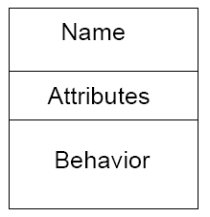
Structural Things
A Class, which is a description of a set of objects that share the same attributes, operations, relationships, and semantics

Slide 52
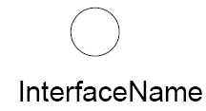
Structural Things
An interface, which is a collection of operations that specify a service of a class or component
Defines set of operation specifications but never a set of operation implementation

Slide 53
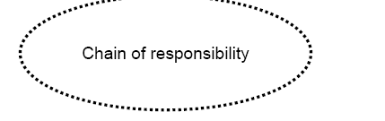
Structural Things
A collaboration, which defines a group or society of roles and other elements working together to provide some cooperative behavior that’s bigger then the sum of all the elements

Slide 54
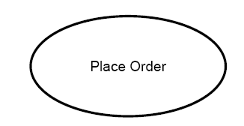
Structural Things
A use case, which is a description of a set of sequence of actions that a system performs that affects an actor

Slide 55

Behavioral Things
Dynamic parts of UML models
An interaction, which is a behavior that comprises a set of messages exchanged among a set of objects

Slide 56
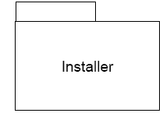
Grouping Things
Grouping things are the organizational parts of UML
Package is a general purpose mechanism for organizing elements into groups

Slide 57
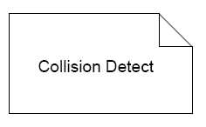
Annotational Things
Explanatory parts of UML

Slide 58

Dependency
A dependency is a semantic relationship between two things in which a change to one thing (the independent thing) may affect the semantics of the other thing (the dependent thing)

Slide 59

Association
An association is a structural relationship that describes a set of links, a link being a connection among objects

Slide 60

Generalization
A generalization is a specialized/generalization in which objects of the specialized element (the child) are substitutable for objects of the generalized element (the parent)

Slide 61

Realization
A realization is a semantic relationship between classifiers, wherein one classifier specifies a contract that another classifier guarantees to carry out

Slide 62
The Unified Modeling Language
UML diagrams represent three different views of a system model:
  Functional requirements view
    Emphasizes the functional requirements of the system from the user's point of view
  Static structural view
    Emphasizes the static structure of the system using objects, attributes, operations and relationships
  Dynamic behavior view
    Emphasizes the dynamic behavior of the system by showing collaborations among objects and changes to the internal states of objects

Slide 63
Class Diagrams
Most common diagrams found in modeling object-oriented systems
Can be used to illustrate the static view of a system
You will usually see the following in a class diagram
  Classes
  Interfaces
  Collaborations
  Dependency, generalization, and association relationships

Slide 64
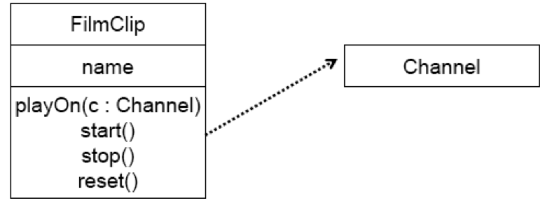
Class Diagrams
There are 3 kinds of relationships that are important:
1) Dependencies are “using” or “has a” relationships
  A Film Clip needs a channel to play audio:

Slide 65
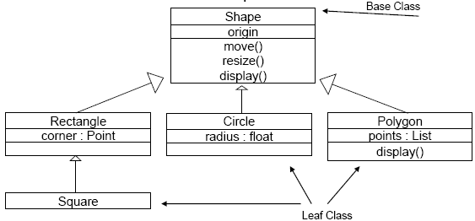
Class Diagrams
2) Generalizations connect generalized classes to more-specialized ones in what is known as subclass/superclass or child/parent relationship
  A sorcerer is a type of Character
  A Square is a type of Rectangle, which is a type of Shape:

Slide 66
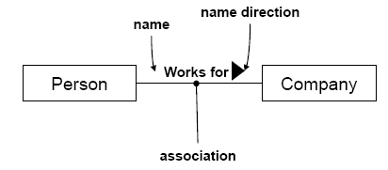
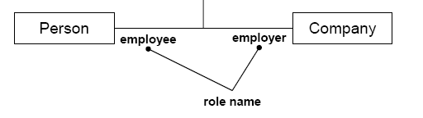
Class Diagrams
3) Associations are structural relationships among instances
  A Person works for a Company:
  Can also include roles:

Slide 67
Object Diagrams
Live applications (runtime) don’t directly use classes
  Instances of classes are used (objects)
  E.g. You may have a zombie class, but when the program runs, it could create 100 zombie objects in memory from that class that walk around and eat people
Graphical representations of the relationships between these instantiated classes at any point of time is called an "Object diagram."
  Looks similar to class diagrams, and uses similar notations for relationships
  Showed as a collection of vertices & arcs

Slide 68
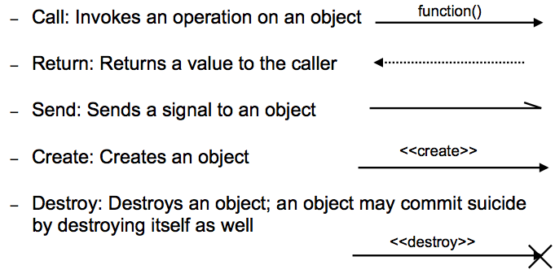
Messages
A message specifies communication between objects that convey information

Slide 69
Interactions
An interaction is a behavior that comprises a set of messages exchanged among a set of objects within a context to accomplish a purpose
You will find interactions
  wherever objects are linked to one another
  In the collaboration of objects that exist in the context of your game or system
  In the context of operation
  In the context of a class

Slide 70
Use Case Diagrams
Used to identify primary elements and processes that form a game
  The primary elements are termed as "actors" and the processes are called "use cases."
  Shows which actors interact with each “use case”

Slide 71
Use Case Diagrams
Actors: Portrays any entity (or entities) that performs certain roles
  The different roles the actor represents are the actual business roles of users/players
  Any number of actors can participate in a system
  Although actors are usually people, they can also be external factors such as Time
Player

Slide 72
Use Case Diagrams
Use case: Visual representation of functionality
  Each game function can be classified as a potential use case.
  As functionality becomes clearer, the underlying use cases become more evident
  Generally, the names should begin with a verb
    Ex. Identify Demon
Save Settings
Load Profile

Slide 73
Use Case Diagrams
System boundary: Defines the scope
  Use cases also need to have definitive limits
  A system boundary of a use case diagram defines the limits
  Shown as a rectangle encasing all use cases
Game
Save Settings
Player
Load Profile

Slide 74
Sequence Diagrams
Depicts sequence of actions that occur
  Shows invocation of methods in each object and the order it occurs in
  This makes sequence diagrams a very useful tool to represent dynamic behavior
  One of the most widely used dynamic diagrams in UML

Slide 75
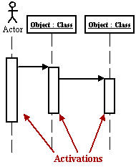
Sequence Diagram: Symbols
Activation boxes represent the time an object needs to complete a task

Slide 76
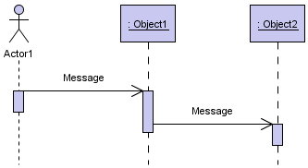
Sequence Diagram: Symbols
Messages are arrows that represent communication between objects
  Use half-arrowed lines to represent asynchronous messages, which are messages are sent that wont wait for a response from the receiver before continuing
Arrow | Message Type
 | Simple
 | Synchronous
 | Asynchronous
 | Return

Slide 77
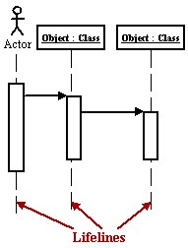
Sequence Diagram: Symbols
Lifelines are vertical dashed lines that indicate the object's presence over time.

Slide 78
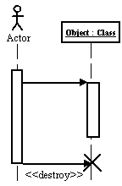
Sequence Diagram: Symbols
Destroying Objects: can be terminated early using an arrow labeled "< < destroy > >" that points to an X

Slide 79
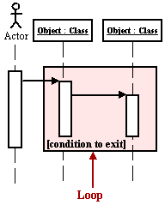
Sequence Diagram: Symbols
Loops are depicted as a rectangle. Place the condition for exiting the loop at the bottom left corner in square brackets [ ].

Slide 80
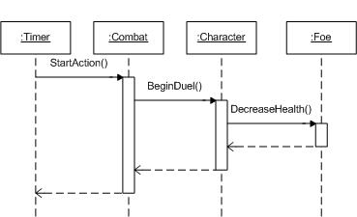
Sequence Diagram
Example

Slide 81
Activity Diagrams
A way to investigate how a use case works
  Expands on the meaning of use cases
  Illustrate workflows
    How control of flow passes through a system
Change Settings
Simple Action
score = score + 2
Syntax for language can be used as well
Process Registration()
Function call

Slide 82
Activity Diagrams: Symbols
Example:
Prepare for speech
fork
Decompress
Gesture()
Synch mouth()
Stream audio
join
Cleanup

Slide 83
Activity Diagrams: Symbols
Start
  Begins a process
Stop
  Ends a process

Slide 84
Activity Diagrams: Symbols
Branching
  Condition based used for alternate paths
  Similar to an if statement
branch
[ False ]
[ True ]

Slide 85
State Machine Diagrams
Specifies the sequence of states an object goes through during its lifetime
  Every object has a lifetime
    On creation, an object is born
    On destruction, an object ceases to exist
    In between, an object may act on other objects, as well as be acted on
  A state machine shows the transitions of its states, such as from idle to an active state

Slide 86
What is a state?
A condition or situation during the life of an object during which it satisfies some condition, performs some activity, or waits for some event
An object remains in a state for a finite amount of time

Slide 87
State Machine Diagrams
final state
initial state
shutDown
keyPress
Idle
Running
finished
name
name
state

Slide 88
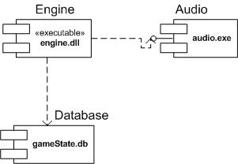
Component Diagrams
Shows how a game is split into physical components
  Shows dependencies among these components
  Examples: sound files, headers, link libraries, modules, executables, packages

Slide 89
Component Diagrams: Analysis
Tabbed rectangles represent components
  A component can be a separate executable, replaceable entity
  Can also represent a collection of files
    In our case, the engine for the game, the music player and the database engine have been set up so that they can be separately installed or updated
  Tagged values or properties can provide supplemental information (e.g. version numbers)
  Stemmed line extending from the Audio component represents an interface, a common feature for components
  Broken lines with open arrows are dependencies
    Engine uses Audio and Database components

Slide 90
Deployment Diagrams
Provides information on the physical location of different components or packages
  Differs from component diagram because it identifies physical hardware locations
  Nodes are physical elements that exists at run time and represents a computational resource
    Represented by a box

Slide 91
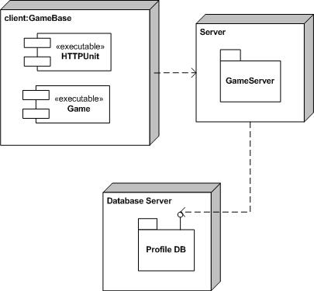
Deployment Diagrams

Slide 92
Deployment Diagrams
The boxes are nodes
  A node can be a server or any other physical device which the system software is installed
The tabbed folders are packages
  A package is usually a group of classes that provide a common service
Packages appear within the nodes, but other elements might appear as well
The dashed lines with open arrows represent dependencies.
  The client package requires a connection to the server node, and the server node requires a connection to the database node

Slide 93
UML Guidelines
You can model 80% of most problems by using about 20% of the UML
A good starting place for using the UML is to model some of the basic abstraction or behaviour that already exist in a game
Only use UML to document useful aspects of your games in the future!

